Slide 1
THERMODYNAMICS
Pavan R Shinde
Asst. Prof.
Department of Chemistry
Government College of Arts and Science,
Chhatrapati Sambhajinaagar

Slide 2
Basic Terms
Thermodynamic Functions:
Properties of a system : T, P, V, w, q, U and S
Thermodynamic function (variable) is a variable of a system which has a fixed value for a given state of the system and it is independent on the path followed to attain that state of the system.
we can calculate change in thermodynamic functions like U, heat content or enthalpy (H), S and free energy (G or A) by algebraic sum of the quantities.
E.g. ∆U = q + w
Path 1: ∆U = q1 + q2 + w1 + q3 + w2
Path 2: ∆U = q1 + w1

Slide 3
Extensive and Intensive Properties
Extensive Properties: depend upon the mass of the system
E.g. mass, volume, energy, Quantity of heat (q), V, U, S, G, heat capacity, etc.
Intensive properties: independent on the mas of the system.
E.g. T, P, density (ρ) , viscosity, surface tension, refractive index, specific heat, Chemical potential (μ)
Ratio of extensive properties is intensive property
e.g. density = m/V,
specific heat capacity = heat capacity/mass

Slide 4
Thermodynamic processes
Isothermal process (T = constant throught the process, ∆T = 0, and hence, ∆U = 0)
Adiabatic process (q = 0, no heat exchange between system and surrounding, no exchange of energy in the form of heat)
Isobaric process (P = constant throughout the process, ∆P = 0)
Isochoric process (V = constant throughout the process, ∆V = 0, and hence, w = 0 )
Reversible process = Ideal process, can return to its initial state, system is always in equilibrium with its surroundings
Irrversible process = Spontaneous / real / natural process.

Slide 5
Reversible and Irreversible processes
Processes which are not reversible are irreversible.
Suppose, a gas at a pressure p is expanding against atmospheric pressure, P;
In this case, p > P for the expansion to occure.
Expansion is reversible if p is infinitesimally greater than the P
i.e. p = P + dp (always infinitesimally greater)
Expansion is irreversible if p is finitely greater than the P
i.e. p = P + cp (always finitely greater)

Slide 6
Expansion work
Expansion work is proportional to the external pressure.
Free expansion (against zero pressure) does no work.
The work of expansion against constant pressure is proportional to that pressure and to the change in volume.
To achieve reversible expansion, the external pressure is matched at every stage to the pressure of the system.
The work of reversible, isothermal expansion of a perfect gas is a logarithmic function of the volume.

Slide 7
Expansion work
Infinitesimal change of state and Infinitesimal change of internal energy dU
dU = dw + dq
A) Total Expansion work done
General expression of work
dw = -Fdz (general definition of work done)
F = P_{ex}A (magnitude of the force acting on the outer face of the piston)
A = Area of massless, frictionless, movable piston which moves out a distance dz, against external pressure P_{ex}
dw = -P_{ex}Adz (Adz is a change in volume, dV)
dw = -P_{ex}dV (Expansion work)

Slide 8
Expansion work
The work done when the system expands by dV against a pressure P_{ex} is, dw = -p_{ex}dV (Expansion work)
B) Free expansion: is expansion against zero pressure
dw = -p_{ex}dV = 0
Hence, overall: w = 0 ( work of free expansion)
That is, no work is done when a system expands freely. Expansion of this kind occurs when a gas expands into a vacuum.

Slide 9
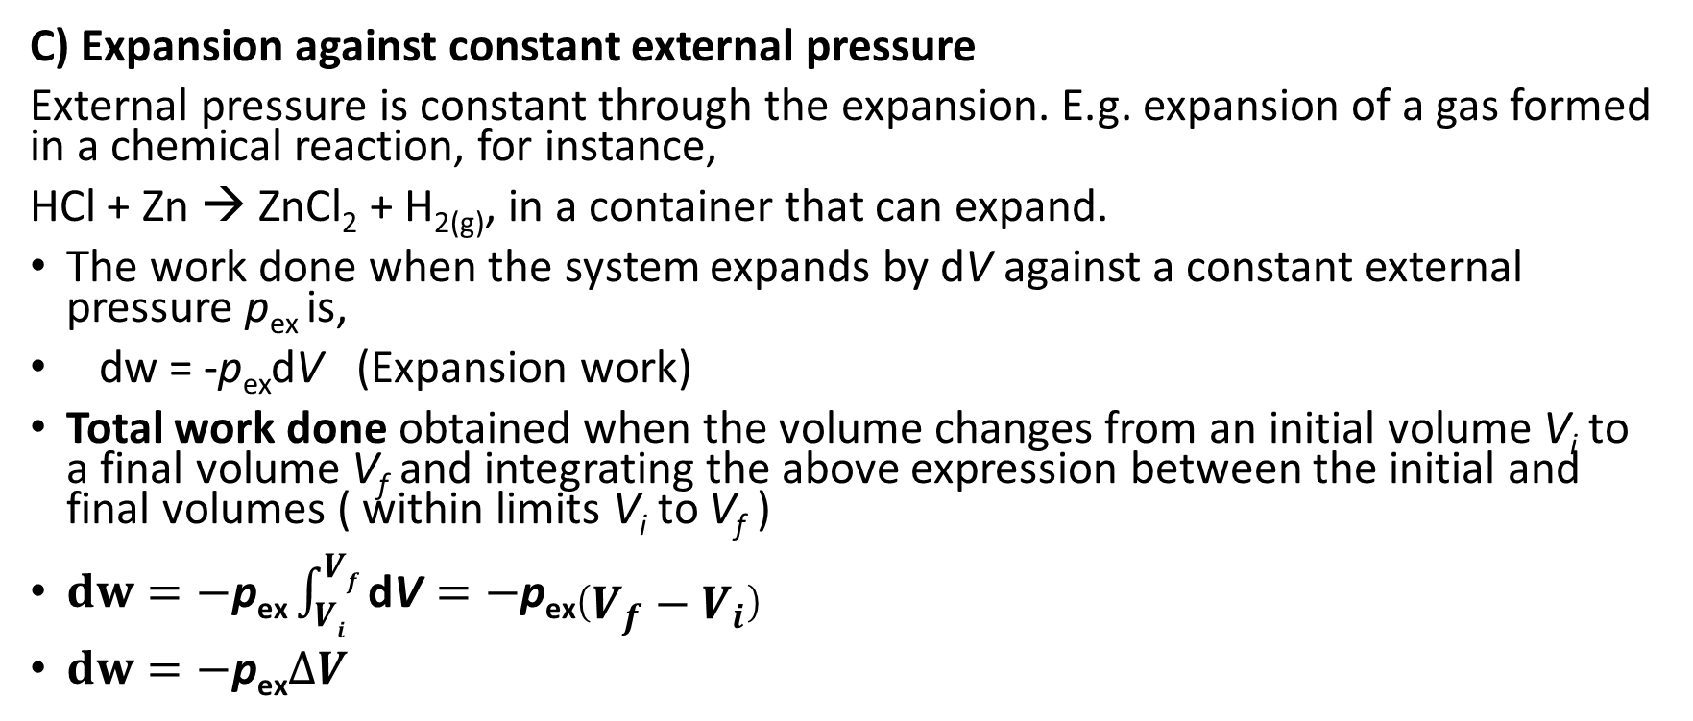
Expansion work
C) Expansion against constant external pressure
External pressure is constant through the expansion. E.g. expansion of a gas formed in a chemical reaction, for instance,
HCl + Zn → ZnCl₂ + H_{2(g)}, in a container that can expand.
The work done when the system expands by dV against a constant external pressure p_{ex} is,
dw = -p_{ex}dV (Expansion work)
Total work done obtained when the volume changes from an initial volume V_{i} to a final volume V_{f} and integrating the above expression between the initial and final volumes ( within limits V_{i} to V_{f} )
$dw=−\text{p}\text{ex}\int_{Vi}^{Vf}{\text{d}\text{V}}=−\text{p}\text{ex}\left(V_{f}−V_{i}\right)$
$dw=−\text{p}\text{ex}∆V$

Slide 10
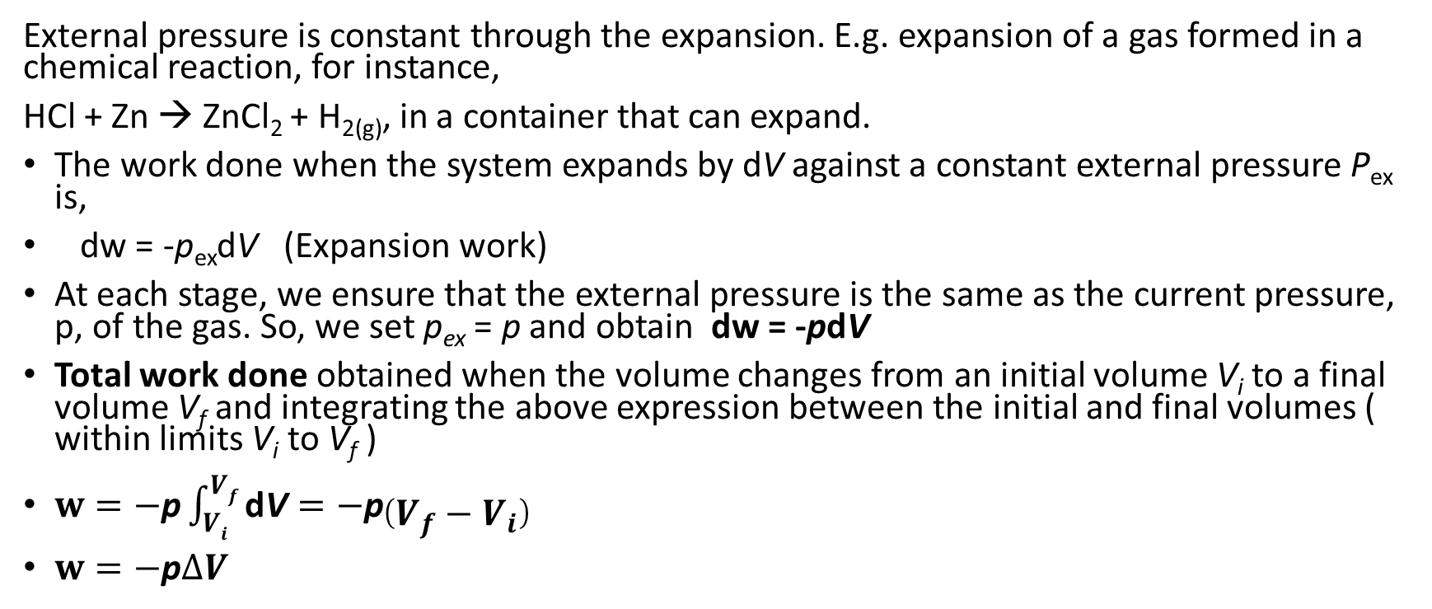
Expansion work
External pressure is constant through the expansion. E.g. expansion of a gas formed in a chemical reaction, for instance,
HCl + Zn → ZnCl₂ + H_{2(g)}, in a container that can expand.
The work done when the system expands by dV against a constant external pressure P_{ex} is,
dw = -p_{ex}dV (Expansion work)
At each stage, we ensure that the external pressure is the same as the current pressure, p, of the gas. So, we set p_{ex} = p and obtain dw = -pdV
Total work done obtained when the volume changes from an initial volume V_{i} to a final volume V_{f} and integrating the above expression between the initial and final volumes ( within limits V_{i} to V_{f} )
$w=−\text{p}\int_{Vi}^{Vf}{\text{d}\text{V}}=−\text{p}\left(V_{f}−V_{i}\right)$
$w=−\text{p}∆V$

Slide 11
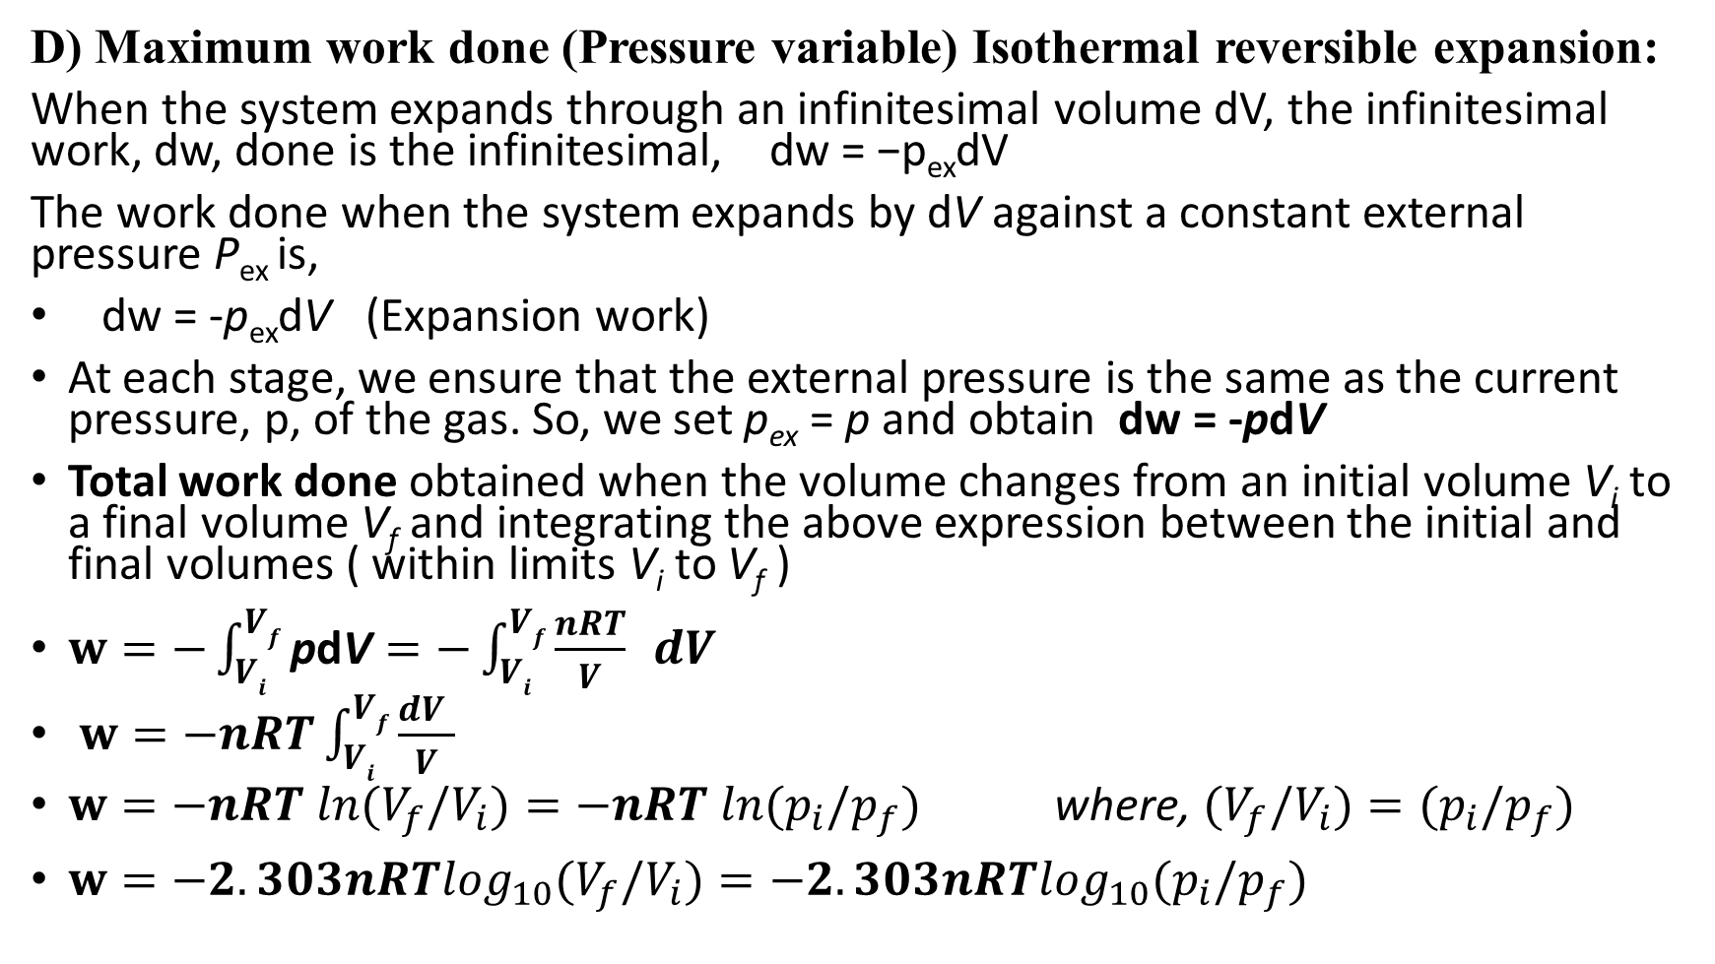
Expansion work
D) Maximum work done (Pressure variable) Isothermal reversible expansion:
When the system expands through an infinitesimal volume dV, the infinitesimal work, dw, done is the infinitesimal, dw = −p_{ex}dV
The work done when the system expands by dV against a constant external pressure P_{ex} is,
dw = -p_{ex}dV (Expansion work)
At each stage, we ensure that the external pressure is the same as the current pressure, p, of the gas. So, we set p_{ex} = p and obtain dw = -pdV
Total work done obtained when the volume changes from an initial volume V_{i} to a final volume V_{f} and integrating the above expression between the initial and final volumes ( within limits V_{i} to V_{f} )
$w=−\int_{Vi}^{Vf}{\text{p}\text{d}\text{V}}=−\int_{Vi}^{Vf}{\frac{nRT}{V} }dV$
$w=−nRT\int_{Vi}^{Vf}{\frac{dV }{V} }$
$w=−nRT ln{(V}_{f}/V_{i})=−nRT ln{(p}_{i}/p_{f})$ where, ${(V}_{f}/V_{i})={(p}_{i}/p_{f})$
$w=−2.303nRT\log_{10}{(V}_{f}/V_{i})=−2.303nRT\log_{10}{(p}_{i}/p_{f})$

Slide 12
Internal Energy
At constant volume, no nonexpansion work: ΔU = q
This relation is commonly written ΔU = q_{V}

Slide 13
Enthalpy
H = U + pV
That is, the enthalpy differs from the internal energy by the addition of the product of the pressure, p, and the volume, V, of the system.
ΔH = ΔU + Δ(pV)
where Δ(pV) = p_{f}V_{f} − p_{i}V_{i} .
If the change takes place at constant pressure p, the second term on the right simplifies to Δ(pV) = pVf − pVi = p(V_{f} − V_{i} ) = pΔV
At constant pressure: ΔH = ΔU + pΔV
H is defined in terms of state functions (U, p, and V), the enthalpy is a state function.
At constant pressure, no nonexpansion work: ΔH = q
This relation is commonly written ΔH = q_{p}
The subscript p signifies that the pressure is held constant.

Slide 14
Enthalpy
H = U + pV
At constant pressure: ΔH = ΔU + pΔV
Consider a system open to the atmosphere, so that its pressure p is constant and equal to the external pressure p_{ex}
we can write ΔH = ΔU + pΔV = ΔU + p_{ex}ΔV
But, ΔU=q+w with w = - p_{ex}ΔV (provided the system does no other kind of work)
ΔH = (−p_{ex} ΔV + q) + p_{ex} ΔV = q
at constant pressure, with no nonexpansion work, we can identify the energy transferred by heating with a change in enthalpy of the system

Slide 15
Enthalpy
Enthalpy is an extensive property.
The molar enthalpy, H_{m} = H/n, of a substance, an intensive property
H_{m} = U_{m} + pV_{m}
For a perfect gas we can go on to write pV_{m} = RT,
and obtain For a perfect gas: H_{m} = U_{m} + RT

Slide 16
Measurement of heat
Heat capacity, C = q/T₂ – T₁ = q/ΔT
specific heat capacity, Cs , the heat capacity divided by the mass of the sample (Cs = C/m, in joules per kelvin per gram, J K−1 g −1 ) or
the molar heat capacity, Cm, the heat capacity divided by the amount of substance (Cm = C/n, in joules per kelvin per mole, J K−1 mol−1 )

Slide 17
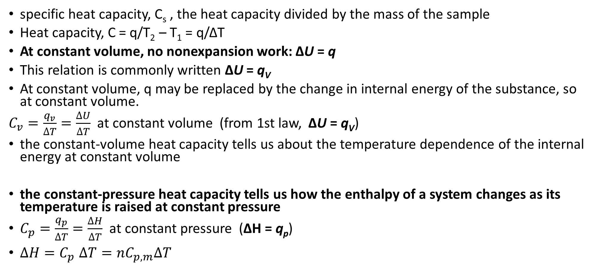
Measurement of heat
specific heat capacity, C_{s} , the heat capacity divided by the mass of the sample
Heat capacity, C = q/T₂ – T₁ = q/ΔT
At constant volume, no nonexpansion work: ΔU = q
This relation is commonly written ΔU = q_{V}
At constant volume, q may be replaced by the change in internal energy of the substance, so at constant volume.
$C_{v}=\frac{q_{v}}{∆T}=\frac{∆U}{∆T}$ at constant volume (from 1st law, ΔU = q_{V})
the constant-volume heat capacity tells us about the temperature dependence of the internal energy at constant volume
the constant-pressure heat capacity tells us how the enthalpy of a system changes as its temperature is raised at constant pressure
$C_{p}=\frac{q_{p}}{∆T}=\frac{∆H}{∆T}$ at constant pressure (ΔH = q_{p})
$∆H{=C}_{p}∆T=nC_{p,m}∆T$

Slide 18
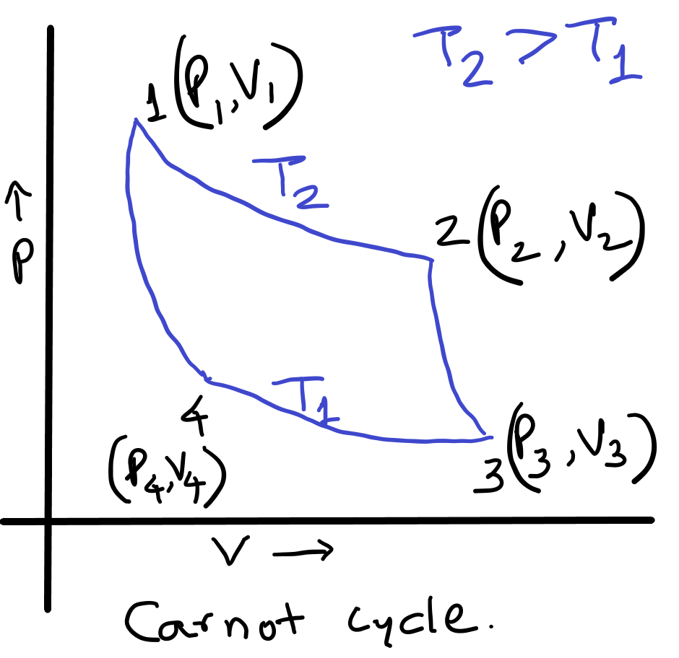
CARNOT CYCLE AND CARNOT ENGINE

Slide 19
Cyclic Process: A thermodynamic process in which a system, after completing a series of changes, returns to original state i.e. completes a cycle, is called cyclic process.
E.g. Carnot cycle, (Sadi Carnot)
Carnot cycle is hypothetical ideal circular process is based on isothermal and adiabatic expansions and compressions.

Slide 20
CARNOT CYCLE
Nicholas Leonard Sadi Carnot, an engineer in French army originated use of cycle (Carnot) in thermodynamic analysis in 1824 and these concepts provided basics upon which second law of thermodynamics was stated by Clausius and others.
Carnot cycle is a reversible thermodynamic cycle comprising of four reversible processes / strokes.
Thermodynamic processes constituting Carnot cycle are;
(i) Reversible isothermal expansion (1–2, Q_{add})
(ii) Reversible adiabatic expansion (2–3, W _{expn})
(iii) Reversible isothermal compression (3–4, Q_{rejected})
(iv) Reversible adiabatic compression (4–1, W _{compr} )

Slide 21
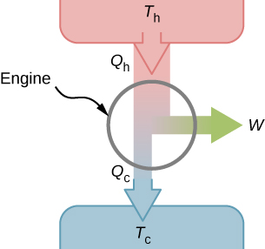
A schematic representation of a heat engine. Energy flows from the hot reservoir to the cold reservoir while doing work.
Ref. / link: https://pressbooks.online.ucf.edu/osuniversityphysics2/chapter/heat-engines

Slide 22
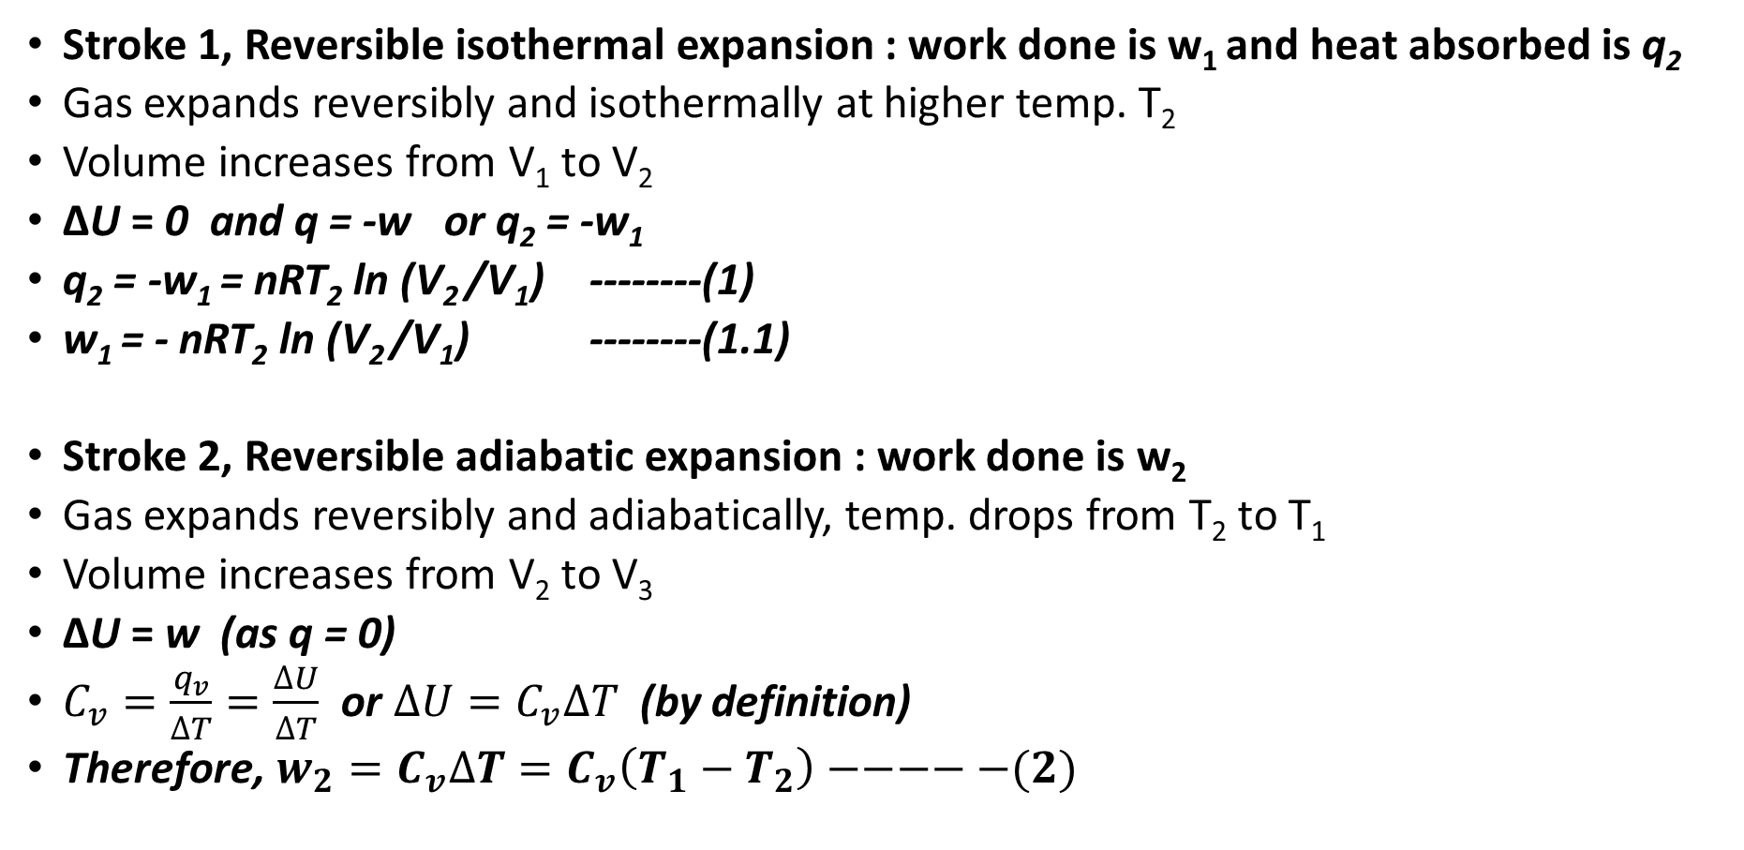
CARNOT CYCLE
Stroke 1, Reversible isothermal expansion : work done is w₁ and heat absorbed is q₂
Gas expands reversibly and isothermally at higher temp. T₂
Volume increases from V₁ to V₂
ΔU = 0 and q = -w or q₂ = -w₁
q₂ = -w₁ = nRT₂ ln (V₂ /V₁) --------(1)
w₁ = - nRT₂ ln (V₂ /V₁) --------(1.1)
Stroke 2, Reversible adiabatic expansion : work done is w₂
Gas expands reversibly and adiabatically, temp. drops from T₂ to T₁
Volume increases from V₂ to V₃
ΔU = w (as q = 0)
$C_{v}=\frac{q_{v}}{∆T}=\frac{∆U}{∆T}$ or $∆U=C_{v}∆T$ (by definition)
Therefore,$w_{2}=C_{v}∆T=C_{v}\left(T_{1}−T_{2}\right)−−−−−(2)$

Slide 23
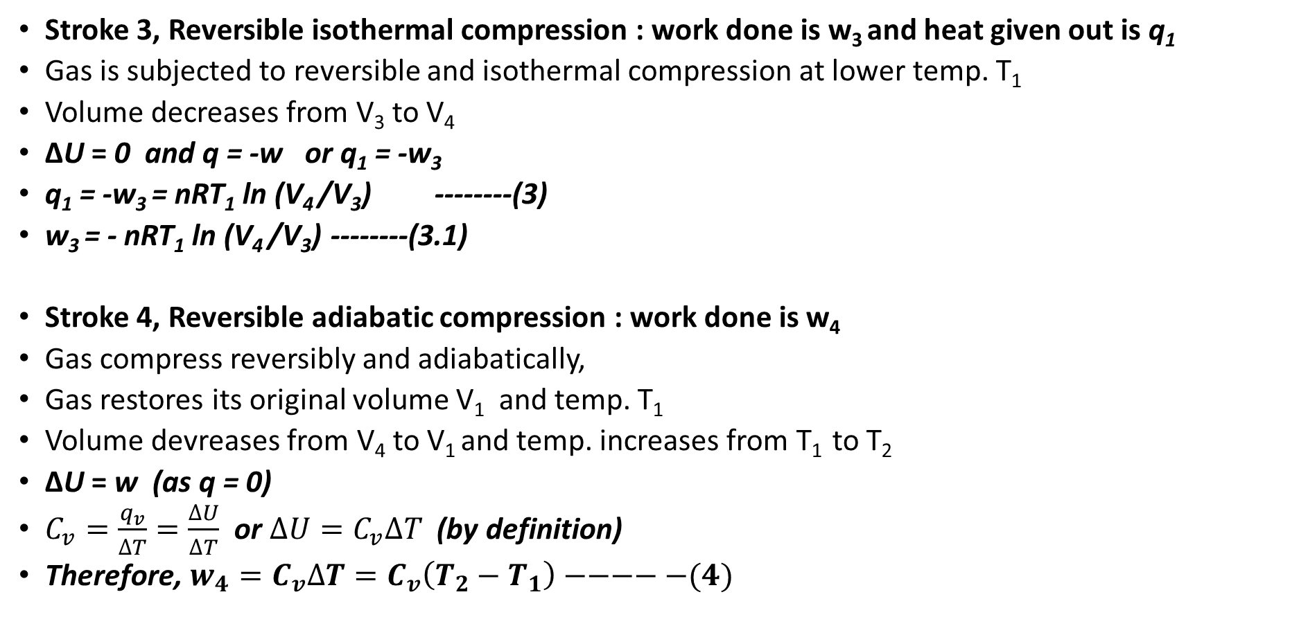
CARNOT CYCLE
Stroke 3, Reversible isothermal compression : work done is w₃ and heat given out is q₁
Gas is subjected to reversible and isothermal compression at lower temp. T₁
Volume decreases from V₃ to V₄
ΔU = 0 and q = -w or q₁ = -w₃
q₁ = -w₃ = nRT₁ ln (V₄ /V₃) --------(3)
w₃ = - nRT₁ ln (V₄ /V₃) --------(3.1)
Stroke 4, Reversible adiabatic compression : work done is w₄
Gas compress reversibly and adiabatically,
Gas restores its original volume V₁ and temp. T₁
Volume devreases from V₄ to V₁ and temp. increases from T₁ to T₂
ΔU = w (as q = 0)
$C_{v}=\frac{q_{v}}{∆T}=\frac{∆U}{∆T}$ or $∆U=C_{v}∆T$ (by definition)
Therefore,$w_{4}=C_{v}∆T=C_{v}\left(T_{2}−T_{1}\right)−−−−−(4)$

Slide 24


A schematic representation of a heat engine. Energy flows from the hot reservoir to the cold reservoir while doing work.
Ref. / link: https://pressbooks.online.ucf.edu/osuniversityphysics2/chapter/heat-engines

Slide 25
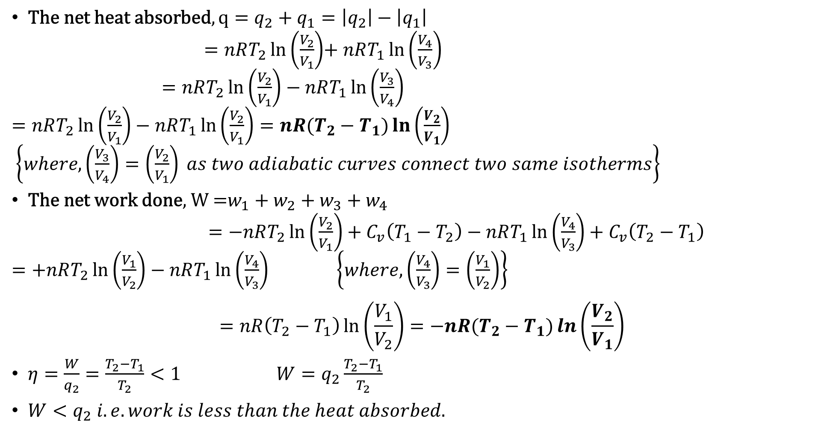
Efficiency of Carnot Heat Engine, $η$
$\text{The} \text{net} \text{heat} \text{absorbed}, q=q_{2}+q_{1}=\left|q_{2}\right|−\left|q_{1}\right|$
$=nRT_{2}\ln\left(\frac{V_{2}}{V_{1}}\right)$+ $nRT_{1}\ln\left(\frac{V_{4}}{V_{3}}\right)$
$=nRT_{2}\ln\left(\frac{V_{2}}{V_{1}}\right)−nRT_{1}\ln\left(\frac{V_{3}}{V_{4}}\right)$
$=nRT_{2}\ln\left(\frac{V_{2}}{V_{1}}\right)−nRT_{1}\ln\left(\frac{V_{2}}{V_{1}}\right)=nR(T_{2}−T_{1})\ln\left(\frac{V_{2}}{V_{1}}\right)$
$\left\{where,\left(\frac{V_{3}}{V_{4}}\right)=\left(\frac{V_{2}}{V_{1}}\right) as two adiabatic curves connect two same isotherms\right\}$
$\text{The} \text{net} \text{work} \text{done}\text{, }\text{W}\text{ =}w_{1}+w_{2}+w_{3}+w_{4}$
$=−nRT_{2}\ln\left(\frac{V_{2}}{V_{1}}\right)+C_{v}\left(T_{1}−T_{2}\right)−nRT_{1}\ln\left(\frac{V_{4}}{V_{3}}\right)+C_{v}\left(T_{2}−T_{1}\right)$
$=+nRT_{2}\ln\left(\frac{V_{1}}{V_{2}}\right)−nRT_{1}\ln\left(\frac{V_{4}}{V_{3}}\right)$ $\left\{where,\left(\frac{V_{4}}{V_{3}}\right)=\left(\frac{V_{1}}{V_{2}}\right)\right\}$
$$=nR\left(T_{2}−T_{1}\right)\ln\left(\frac{V_{1}}{V_{2}}\right)=−nR(T_{2}−T_{1})\ln\left(\frac{V_{2}}{V_{1}}\right)$$
$η=\frac{W}{q_{2}}=\frac{T_{2}−T_{1}}{T_{2}}<1 W=q_{2}\frac{T_{2}−T_{1}}{T_{2}}$
${W<q}_{2} i.e. work is less than the heat absorbed.$

Slide 26
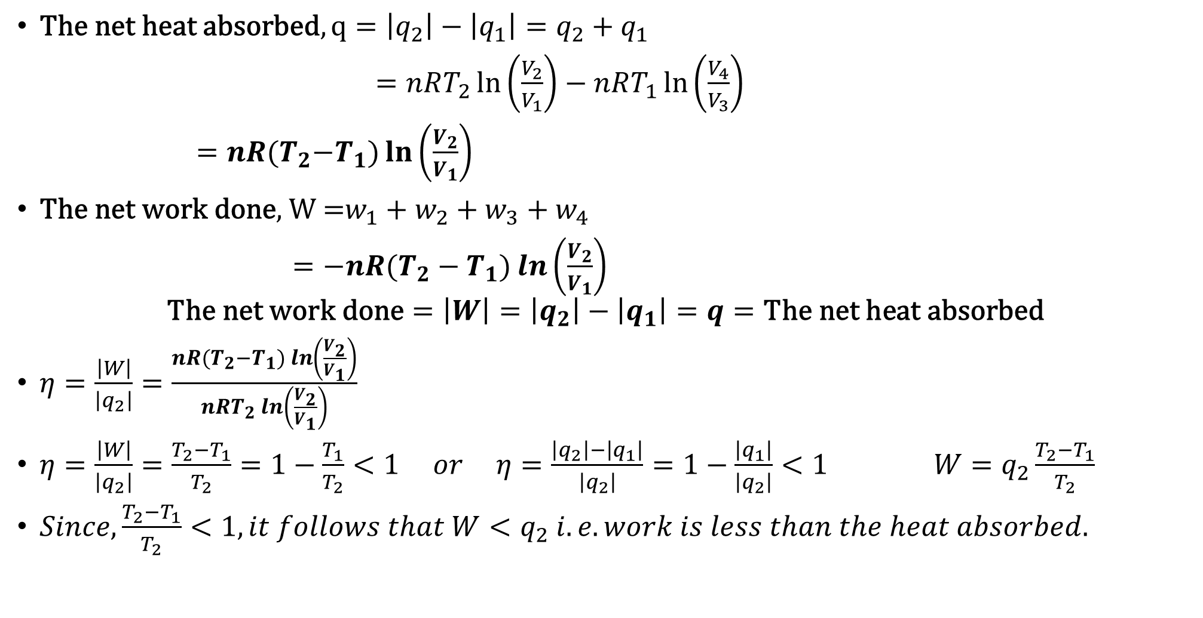
Efficiency of Carnot Heat Engine, $η$
$\text{The} \text{net} \text{heat} \text{absorbed}, q=\left|q_{2}\right|−\left|q_{1}\right|=q_{2}+q_{1}$
$=nRT_{2}\ln\left(\frac{V_{2}}{V_{1}}\right)−$ $nRT_{1}\ln\left(\frac{V_{4}}{V_{3}}\right)$
$=nR(T_{2}{−T}_{1})\ln\left(\frac{V_{2}}{V_{1}}\right)$
$\text{The} \text{net} \text{work} \text{done}\text{, }\text{W}\text{ =}w_{1}+w_{2}+w_{3}+w_{4}$
$=−nR(T_{2}−T_{1})\ln\left(\frac{V_{2}}{V_{1}}\right)$
$$\text{The} \text{net} \text{work} \text{done}=\left|W\right|=\left|q_{2}\right|−\left|q_{1}\right|=q=\text{The} \text{net} \text{heat} \text{absorbed}$$
$η=\frac{\left|W\right|}{\left|q_{2}\right|}=\frac{nR(T_{2}−T_{1})\ln\left(\frac{V_{2}}{V_{1}}\right)}{nRT_{2}\ln\left(\frac{V_{2}}{V_{1}}\right)}$
$η=\frac{\left|W\right|}{\left|q_{2}\right|}=\frac{T_{2}−T_{1}}{T_{2}}=1−\frac{T_{1}}{T_{2}}<1 or η=\frac{\left|q_{2}\right|−\left|q_{1}\right|}{\left|q_{2}\right|}=1−\frac{\left|q_{1}\right|}{\left|q_{2}\right|}<1 W=q_{2}\frac{T_{2}−T_{1}}{T_{2}}$
${Since,\frac{T_{2}−T_{1}}{T_{2}}<1, it follows that W<q}_{2} i.e. work is less than the heat absorbed.$

Slide 27
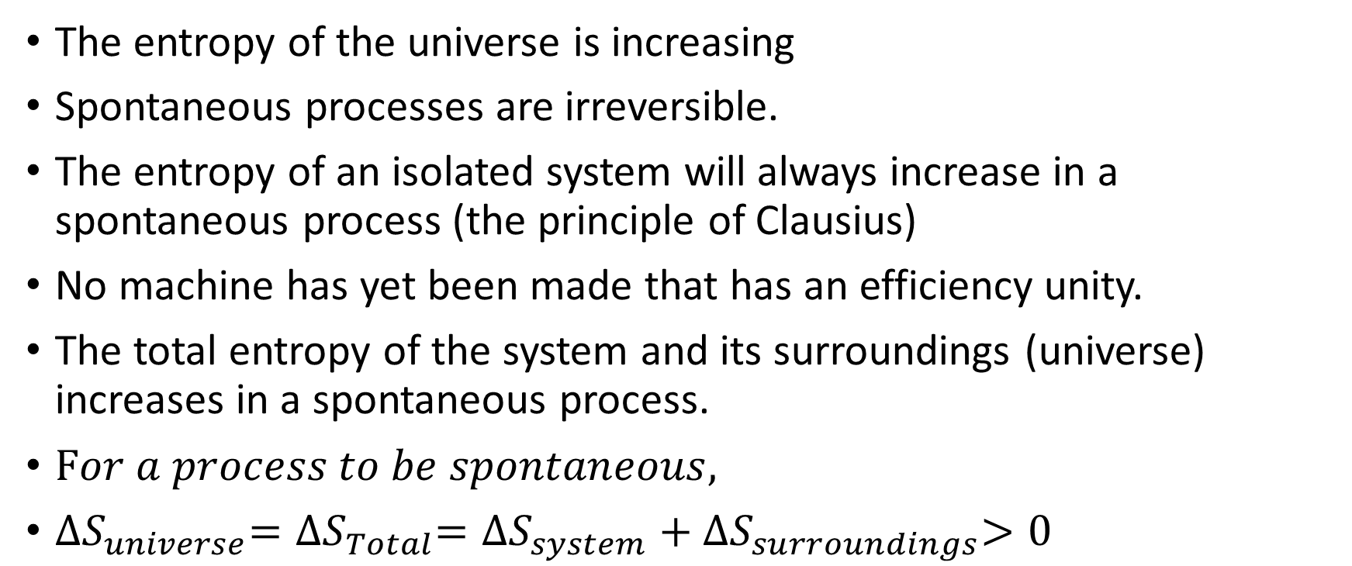
Statements of the Second Law
The entropy of the universe is increasing
Spontaneous processes are irreversible.
The entropy of an isolated system will always increase in a spontaneous process (the principle of Clausius)
No machine has yet been made that has an efficiency unity.
The total entropy of the system and its surroundings (universe) increases in a spontaneous process.
$For a process to be spontaneous,$
${∆S}_{universe}={∆S}_{Total}={∆S}_{system}+{∆S}_{surroundings}>0$

Slide 28
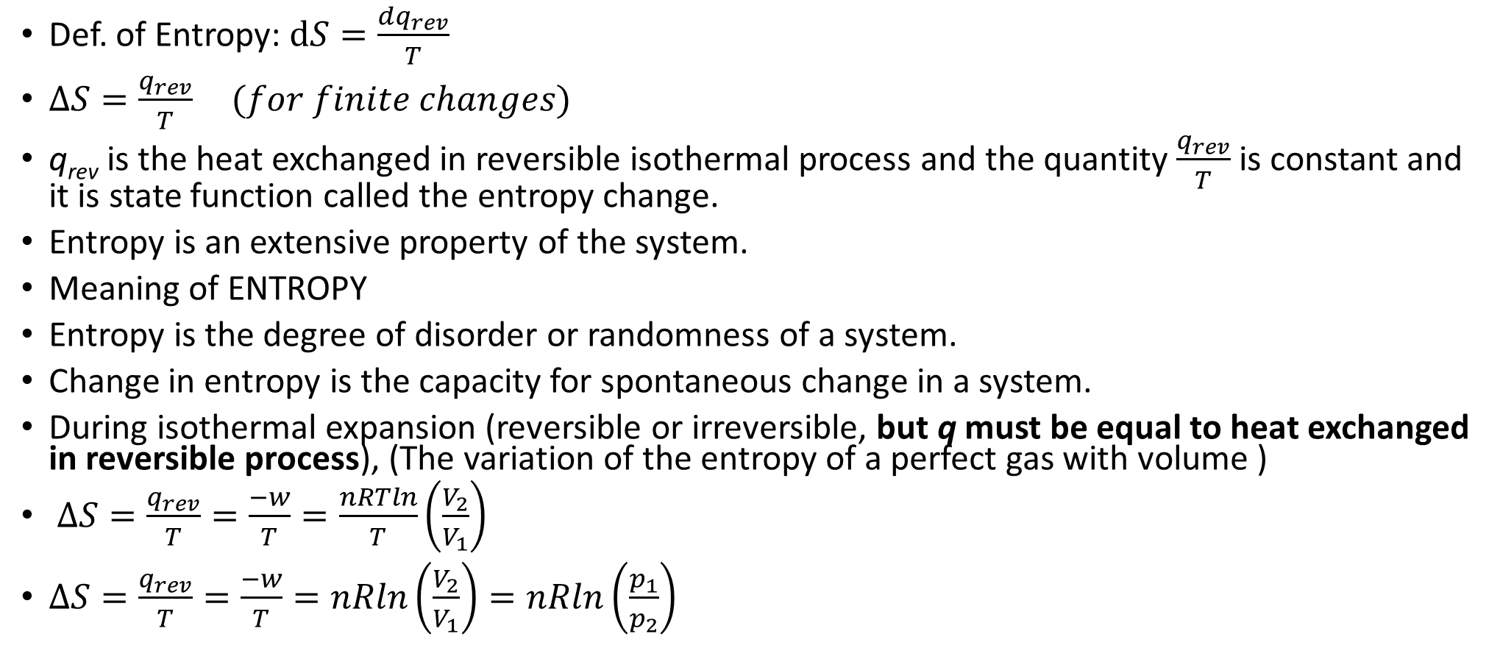
Entropy, (S)
Def. of Entropy: $dS=\frac{{dq}_{rev}}{T}$
$∆S=\frac{q_{rev}}{T} (for finite changes)$
q_{rev} is the heat exchanged in reversible isothermal process and the quantity $\frac{q_{rev}}{T}$ is constant and it is state function called the entropy change.
Entropy is an extensive property of the system.
Meaning of ENTROPY
Entropy is the degree of disorder or randomness of a system.
Change in entropy is the capacity for spontaneous change in a system.
During isothermal expansion (reversible or irreversible, but q must be equal to heat exchanged in reversible process), (The variation of the entropy of a perfect gas with volume )
$∆S=\frac{q_{rev}}{T}=\frac{−w}{T}=\frac{nRTln}{T}\left(\frac{V_{2}}{V_{1}}\right)$
$∆S=\frac{q_{rev}}{T}=\frac{−w}{T}=nRln\left(\frac{V_{2}}{V_{1}}\right)=nRln\left(\frac{p_{1}}{p_{2}}\right)$

Slide 29
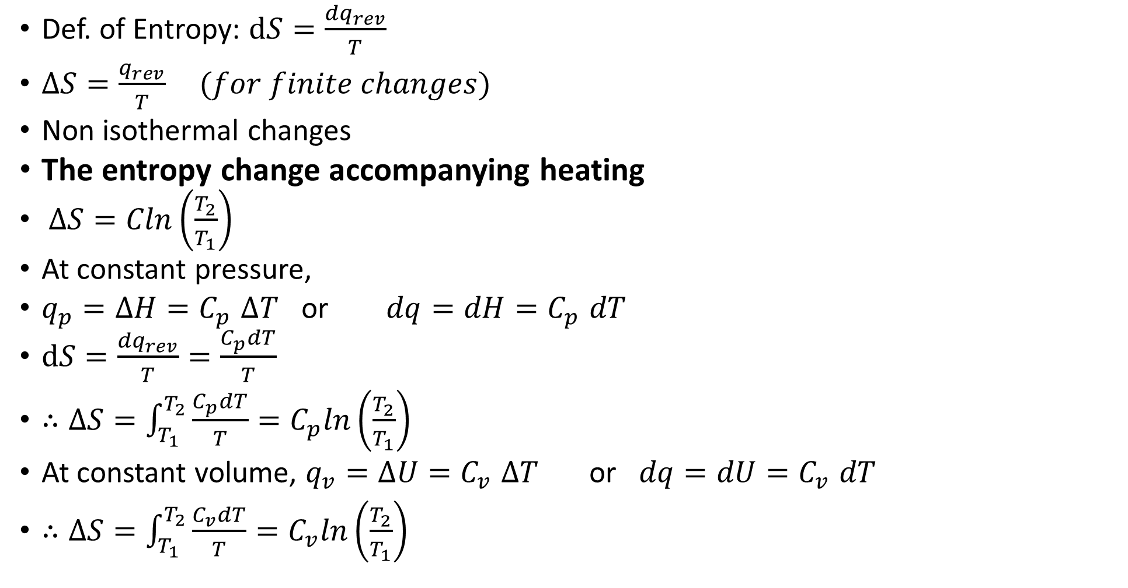
Entropy, (S)
Def. of Entropy: $dS=\frac{{dq}_{rev}}{T}$
$∆S=\frac{q_{rev}}{T} (for finite changes)$
Non isothermal changes
The entropy change accompanying heating
$∆S=Cln\left(\frac{T_{2}}{T_{1}}\right)$
At constant pressure,
$q_{p}=∆H{=C}_{p}∆T$ or $dq=dH{=C}_{p}dT$
$dS=\frac{{dq}_{rev}}{T}=\frac{C_{p}dT}{T}$
$∴∆S=\int_{T_{1}}^{T_{2}}{\frac{C_{p}dT}{T}}=C_{p}ln\left(\frac{T_{2}}{T_{1}}\right)$
At constant volume, $q_{v}=∆U{=C}_{v}∆T$ or $dq=dU{=C}_{v}dT$
$∴∆S=\int_{T_{1}}^{T_{2}}{\frac{C_{v}dT}{T}}=C_{v}ln\left(\frac{T_{2}}{T_{1}}\right)$

Slide 30
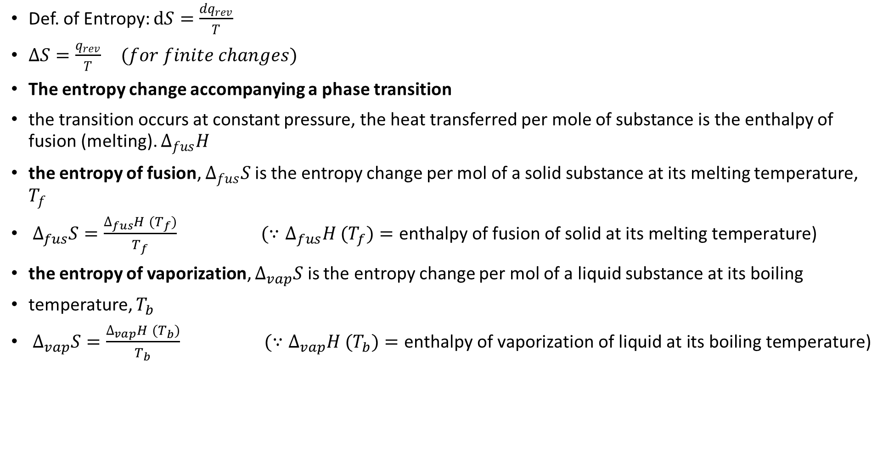
Entropy, (S)
Def. of Entropy: $dS=\frac{{dq}_{rev}}{T}$
$∆S=\frac{q_{rev}}{T} (for finite changes)$
The entropy change accompanying a phase transition
the transition occurs at constant pressure, the heat transferred per mole of substance is the enthalpy of fusion (melting). $∆_{fus}H$
the entropy of fusion, $∆_{fus}S$ is the entropy change per mol of a solid substance at its melting temperature, $T_{f}$
$∆_{fus}S=\frac{∆_{fus}H {(T}_{f})}{T_{f}}$ ${ (∵∆}_{fus}H {(T}_{f})=\text{enthalpy} \text{of} \text{fusion} \text{of} \text{solid} \text{at} \text{its} \text{melting} \text{temperature}\text{)}$
the entropy of vaporization, $∆_{vap}S$ is the entropy change per mol of a liquid substance at its boiling
temperature, $T_{b}$
$∆_{vap}S=\frac{∆_{vap}H {(T}_{b})}{T_{b}}$ ${ (∵∆}_{vap}H {(T}_{b})=\text{enthalpy} \text{of} \text{vaporization} \text{of} \text{liquid} \text{at} \text{its} \text{boiling} \text{temperature}\text{)}$

Slide 31
Third Law of thermodynamics: The entropies of all perfectly crystalline substances are the same at T = 0.
For convenience, we take this common value to be zero.
Then, with this convention, according to the Third Law, S(0) = 0 for all perfectly ordered crystalline materials.

Slide 32
Now we take a very important step. First, we introduce the Gibbs energy, G, which is defined as G = H − TS
At constant temperature: ΔG = ΔH − TΔS
The difference in sign between ΔG and ΔStotal implies that the condition for a process being spontaneous changes from ΔS_{total} > 0 in terms of the total entropy (which is universally true) to ΔG < 0 in terms of the Gibbs energy (for processes occurring at constant temperature and pressure).
That is, in a spontaneous change at constant temperature and pressure, the Gibbs energy decreases
A second feature of the Gibbs energy is that the value of ΔG for a process gives the maximum nonexpansion work that can be extracted from the process at constant temperature and pressure.

Slide 33
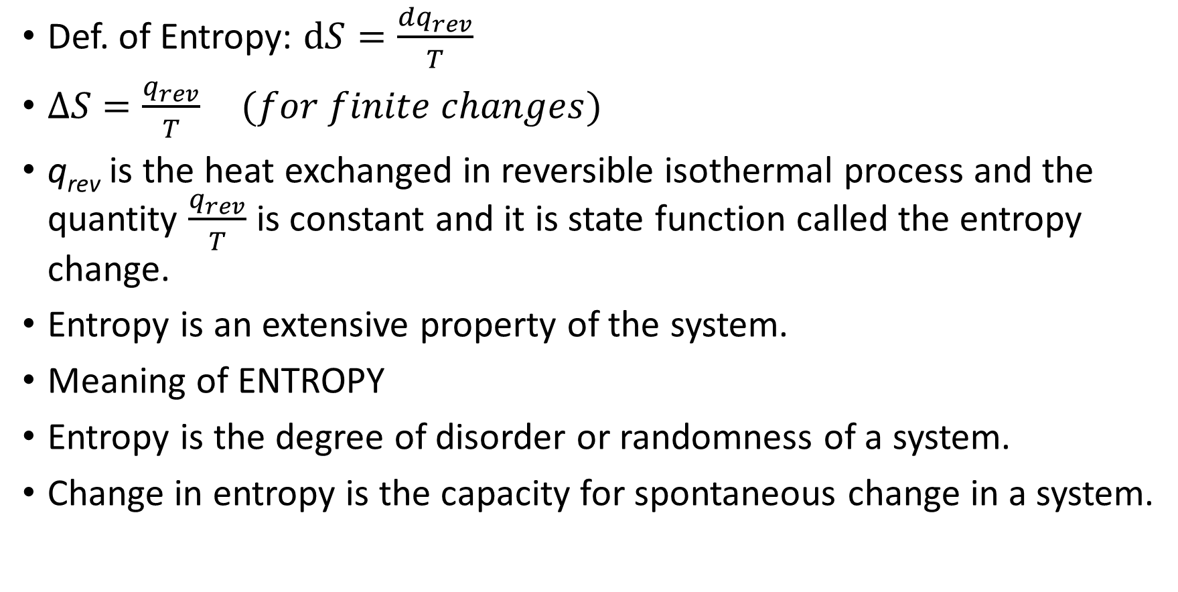
Physical Significance of Entropy, (S)
Def. of Entropy: $dS=\frac{{dq}_{rev}}{T}$
$∆S=\frac{q_{rev}}{T} (for finite changes)$
q_{rev} is the heat exchanged in reversible isothermal process and the quantity $\frac{q_{rev}}{T}$ is constant and it is state function called the entropy change.
Entropy is an extensive property of the system.
Meaning of ENTROPY
Entropy is the degree of disorder or randomness of a system.
Change in entropy is the capacity for spontaneous change in a system.

Slide 34
References
Atkins’ Physical Chemistry
Physical Chemistry – Puri, Sharma and Pathania,
Physical Chemistry – S. Chand publication.

